Slide 2
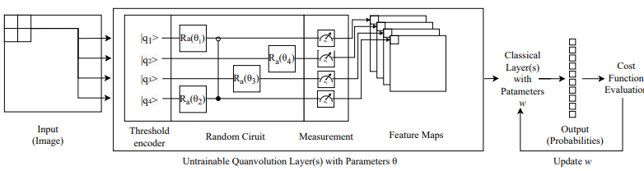



Pixels
$$U_{3}(θ)$$
Flatten & Normalize
Amplitude
Encoding
$$U_{2}(θ)$$
Measure
$$U_{1}(θ)$$
Flatten & Normalize

Slide 3




















$$|q_{0}⟩$$
$$|q_{0}⟩$$
$${ R}_{X}$$
$$|q_{0}⟩$$
$${ R}_{X}$$
$$|q_{1}⟩$$
$${ R}_{Y}$$
$$|q_{1}⟩$$
$${ R}_{X}$$
$$|q_{1}⟩$$
$${ R}_{X}$$
$$|q_{2}⟩$$
$${ R}_{Y}$$
$$|q_{2}⟩$$
$${ R}_{X}$$
$$|q_{2}⟩$$
$${ R}_{X}$$
$$|q_{3}⟩$$
$${ R}_{Y}$$
$$|q_{3}⟩$$
$$|q_{3}⟩$$
$${ R}_{X}$$
a)
b)
c)
$$|q_{0}⟩$$
$${ R}_{X}$$
$${ R}_{X}$$
$${ R}_{X}$$
$$|q_{1}⟩$$
$${ R}_{X}$$
$${ R}_{X}$$
$${ R}_{X}$$
d)
$$|q_{2}⟩$$
$${ R}_{X}$$
$${ R}_{X}$$
$${ R}_{X}$$
$$|q_{3}⟩$$
$${ R}_{X}$$
$${ R}_{X}$$
$${ R}_{X}$$

